Slide 1

Project II STOCK MANAGEMENT SYSTEM
BY: MILAN KARKI
Tu Register No: 6-2-712-52-2019
Roll No: 5

Slide 2
Project analysis slide 2
Introduction
Stock Management is the practice of ordering, storing, tracking, and controlling inventory
In other words, stock management covers every aspect of a business’s inventory.
Stock Management System helps in the efficient monitoring of constant flow of units into and out of an existing inventory.
This process usually involves controlling the transfer in of units in order to prevent the inventory from becoming too high, or to low so that the operation of the company into difficulties.

Slide 3
Project analysis slide 2
Problem Statement
The main problem that occur in several company or retailer is a system to calculate the amount of stocks stored or needed.
Based on my Research, I have found that there are company that still using paper based or filing system to save their information or details about their stocks.
Heavily manual work will involve in managing and maintaining data which is time-consuming if the administrators or manager want to trace the product status, product information and etc.
This also may lead to a situation where the workers forgot to update the inventory manually or worst may lead to miscount when using manual system.

Slide 4
Project analysis slide 2
Objective
1. To design and develop a user friendly system which handles the information of items or products and calculated it to manage the information system.
2. To develop a system that deals with the day-to-day needs of organization like managing purchase, sales, return, and available stocks.
3. Keep each and every calculation and help to generate reports of transactions in Excel, PDF format.
4. Ease of printing the reports of every transaction like purchase, sales, and return

Slide 5
Project analysis slide 2
Scope and Limitation
SCOPE
LIMITATION
All authorized users with proper access credentials can use this system to manage Stock.
The system allows users to easily input, track, and update stock levels.
The system provides reports and analytics to help users make informed decisions about purchasing and inventory management.
Keep each and every calculation and help to generate reports of transactions in Excel, PDF format.
Ease of printing the reports of every transaction like purchase, sales, and return,
The accuracy of inventory levels depends on the accuracy of data input by users.
The system may not be able to integrate with all other business software, depending on compatibility.
The system may require additional hardware or software to function properly, which can increase costs.
The system may have limited functionality for certain industries or types of businesses.
The system has limited amount of category.

Slide 6
Project analysis slide 2
Report Organization
Chapter 1: Describes Introduction of the project, Problem statement, Objective, Scope and Limitation of the project.
Chapter 2: Describes Background Study and Overview of related existing systems.
Chapter 3: Describes System Analysis, Requirement Analysis, and Design including Use Case Diagram, Gantt chart, Entity Relationship Diagram and Dataflow Diagram.
Chapter 4: Presents the Implementation, Testing and debugging are explained.
Chapter 5: Presents the Conclusion on Limitations and Future Enhancement are briefly explained.

Slide 7
Project analysis slide 2
Background Study
1.User Interface: The system should have a user-friendly interface that allows users to easily navigate through the system and perform various actions such as adding or editing stock items, generating reports, and managing inventory levels.
2.Dashboard: The system should have a dashboard that provides a quick overview of stock levels, sales trends, and other important metrics.
3.Stock Tracking: The system should be able to track stock levels for each item, including current stock levels, incoming stock, and outgoing stock..
4.Purchase Order Management: The system should allow users to create and manage purchase orders for stock items, including tracking the status of each order.
5.Sales Order Management: The system should allow users to create and manage sales orders for stock items, including tracking the status of each order.
6.Reporting: The system should provide a range of reports, including stock levels, sales trends, and inventory turnover, to help users make informed decisions.

Slide 8
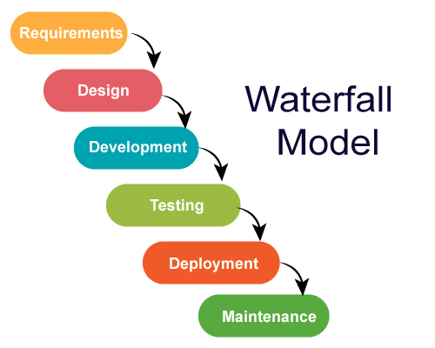
Project analysis slide 2
System Analysis
Waterfall methodology is used while building the website.
This project has specific documentation, fixed time, fixed requirements, well-understanding technology so in order to build this system waterfall methodology can be properly utilized.
Fig 1: Waterfall Model

Slide 9
Project analysis slide 2
Requirements
Functional requirement
User Module:
• User shall login the system.
• User shall Manage Purchase, Sales, and Return Orders.
• User shall print Purchase, Sales, Return Orders and Exporting data into excel or PDF.
• User shall View Back Order.
• User shall view available Stocks.
Admin Module:
• Admin shall login the system.
• Admin shall Manage Purchase, Sales, and Return Orders.
• Admin shall see the registered users and create the user.
• Admin shall delete the user.
• Admin shall view available Stocks.
• Admin shall print Purchase, Sales, Return Orders and Exporting data into excel or PDF
• Admin shall manage supplier.
• Admin shall manage Item list.

Slide 10
Project analysis slide 2
Requirements
Non-Functional Requirement
Performance: The system should be designed to handle large amounts of data and transactions with minimal response time. It should be able to process multiple user requests simultaneously without affecting system performance.
Reliability: The system should be reliable and available at all times. It should be able to recover from any failures or crashes without losing data or disrupting business operations.
Security: The system should be secure and protect sensitive inventory and customer data. It should be designed to prevent unauthorized access, data breaches, and other security threats.
Usability: The system should be user-friendly and easy to use, with a well-designed user interface and clear navigation. It should be able to support multiple languages and be accessible to users with disabilities.
Scalability: The system should be able to scale to handle increased data volumes, users, and transactions as the business grows. It should be designed to handle future expansion without significant system redesign.

Slide 11
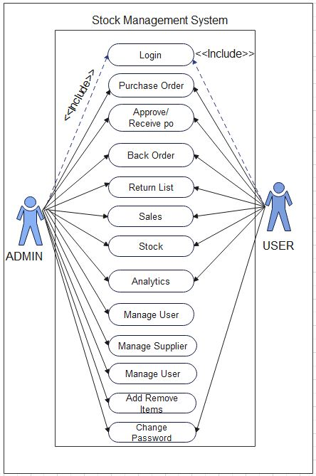
Project analysis slide 4
Use Case Diagram
Fig 2: Use Case Diagram

Slide 12
Project analysis slide 2
Feasibility Study
Feasibility study
Technical feasibility: In order to design this system, it uses existing technologies, software and hardware so there is no technological hurdle to build this system.
Economic feasibility: The system development does not have any requirement of expensive hardware and software, and used software are mostly open source so development is economically feasible.
Operational feasibility: The proposed system is operationally feasible as it is reliable for all type of user i.e., whether or not the user has the knowledge of computer or not. It is simple and easy to use due to simple user interface and its operational feasible.
Schedule Feasibility: The system that we developed is scheduling feasible as it does not require more time for the development phase.

Slide 13
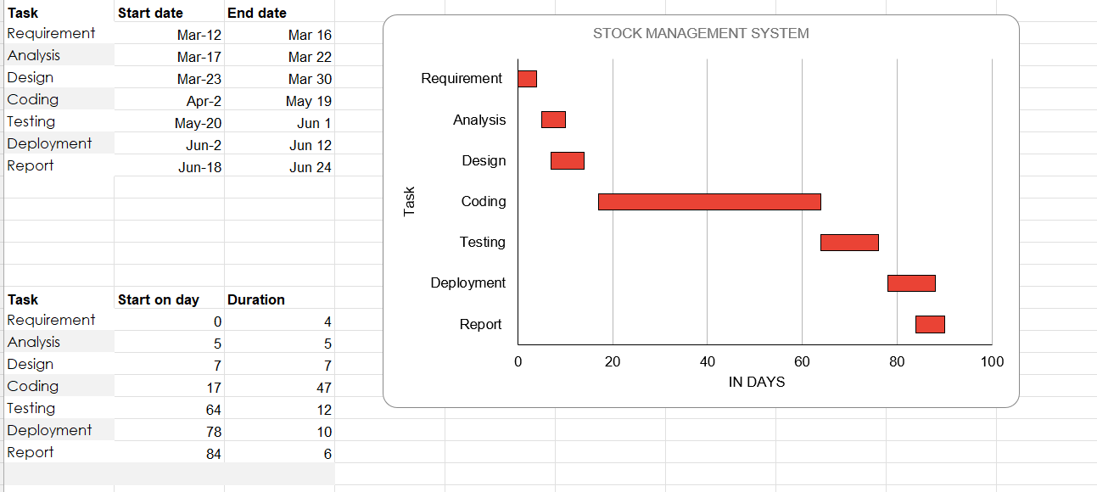
Project analysis slide 2
Gantt Chart
Gantt chart is used for planning projects of all sizes, and it is a useful way of showing what work is scheduled to be done on a specific day.
It can also help you view the start and end dates of a project in one simple chart.
.
Fig 3: Gantt Chart

Slide 14
Project analysis slide 2
Tools and Technology
Tools and Technology Used:
The Following software is used for the development of the System.
VS Code
MySQL
Apache [Xampp]
.

Slide 15
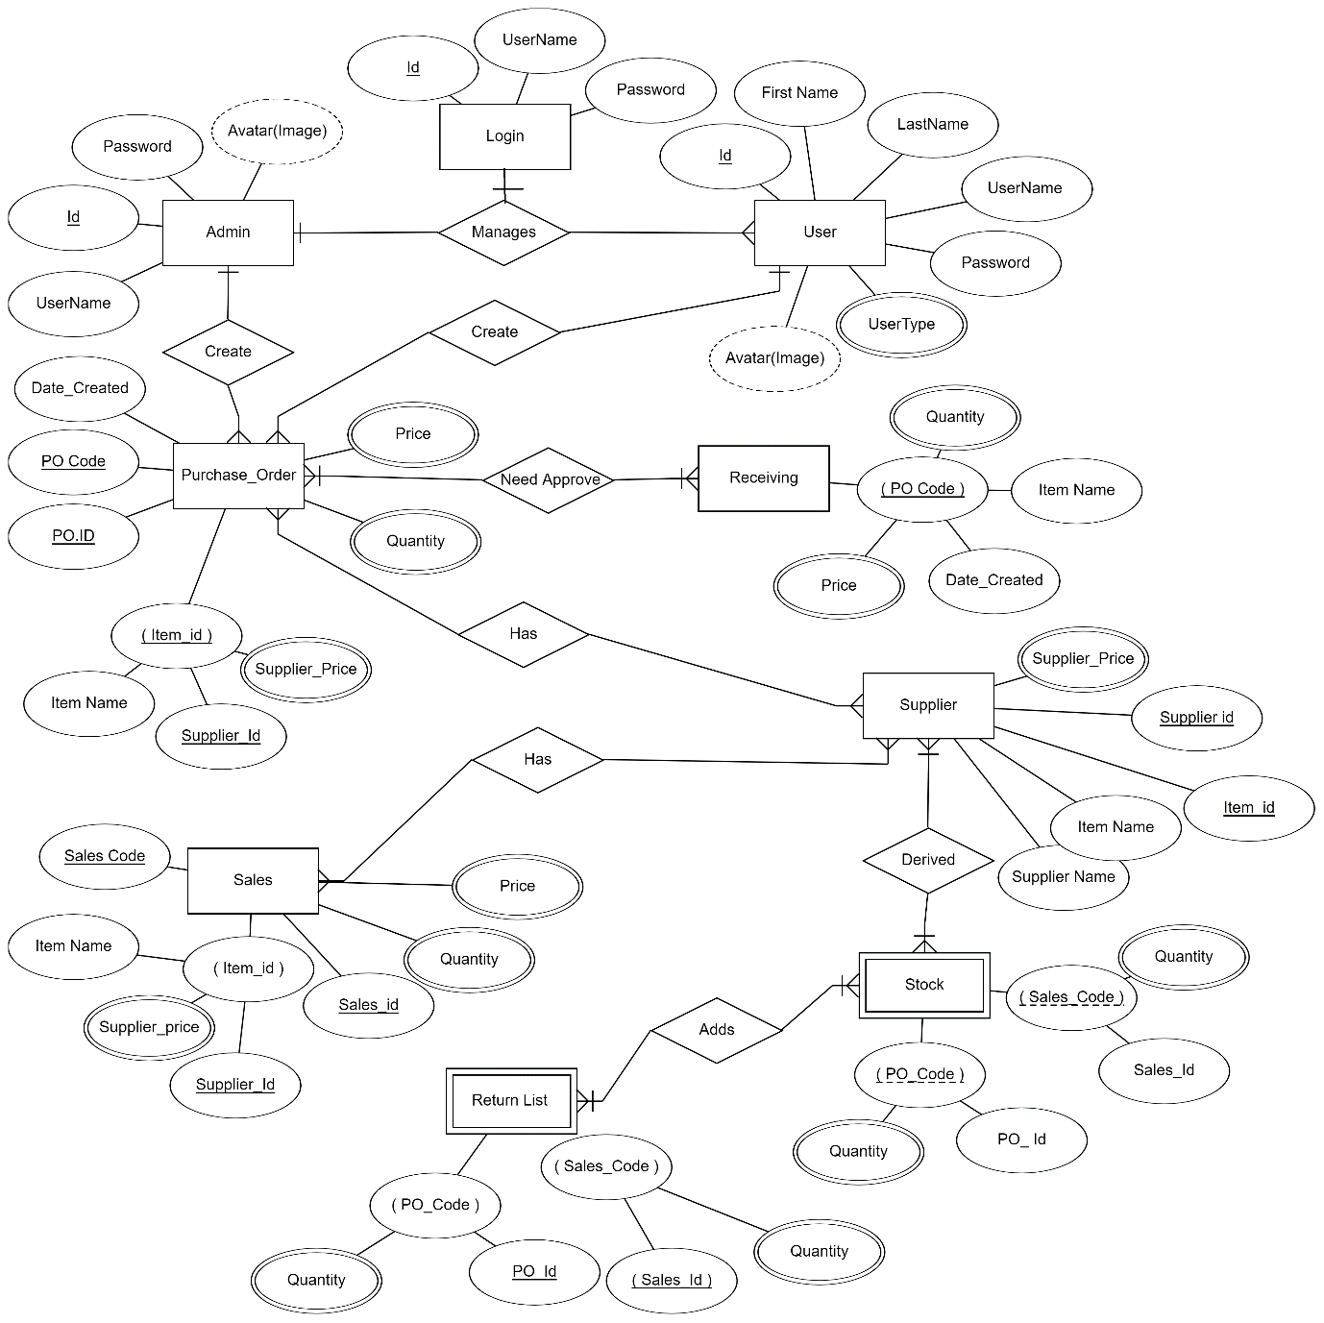
Project analysis slide 4
Entity Relationship Diagram
Fig 4: Entity Relationship Diagram

Slide 16
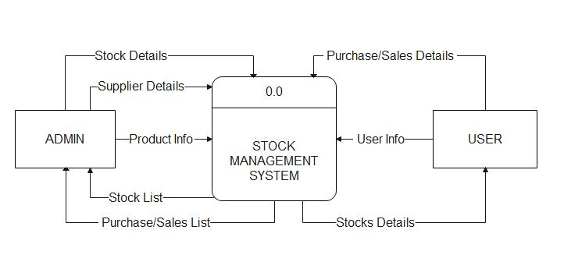
Project analysis slide 4
Process Modelling (DFD)
Fig 5.1: DFD Diagram (Level 0 DFD)

Slide 17
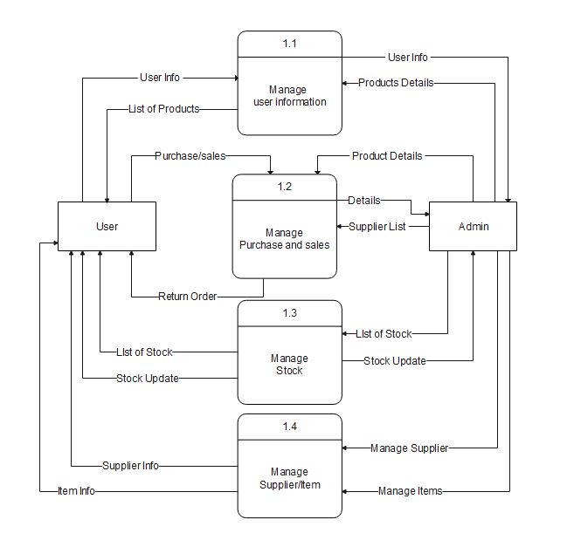
Project analysis slide 4
Process Modelling (DFD)
Fig 5.2: DFD Diagram (Level 1 DFD)

Slide 18
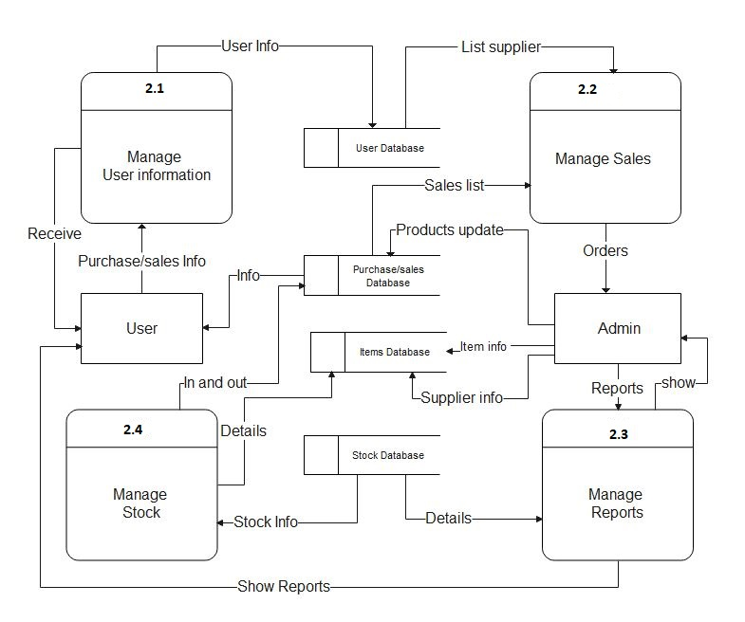
Project analysis slide 4
Process Modelling (DFD)
Fig 5.3: DFD Diagram (Level 2 DFD)

Slide 19
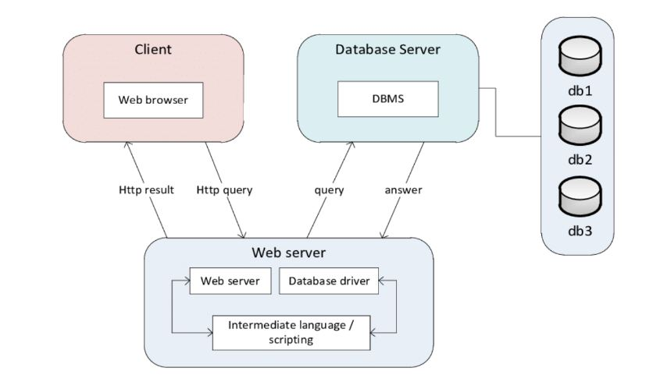
Project analysis slide 4
Architecture Design
Fig 6: Architecture Design

Slide 20
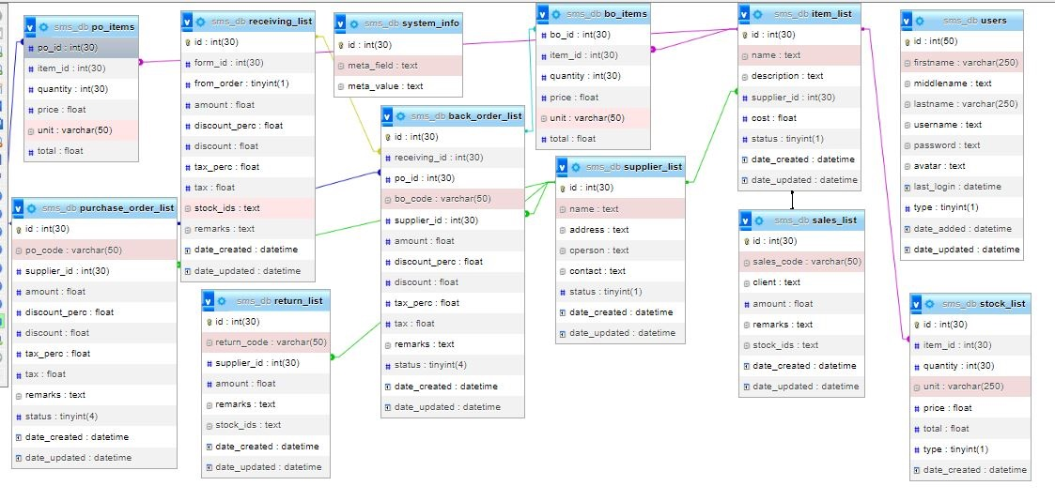
Project analysis slide 4
Database Schema Design
Fig7: Database Schema Design

Slide 21
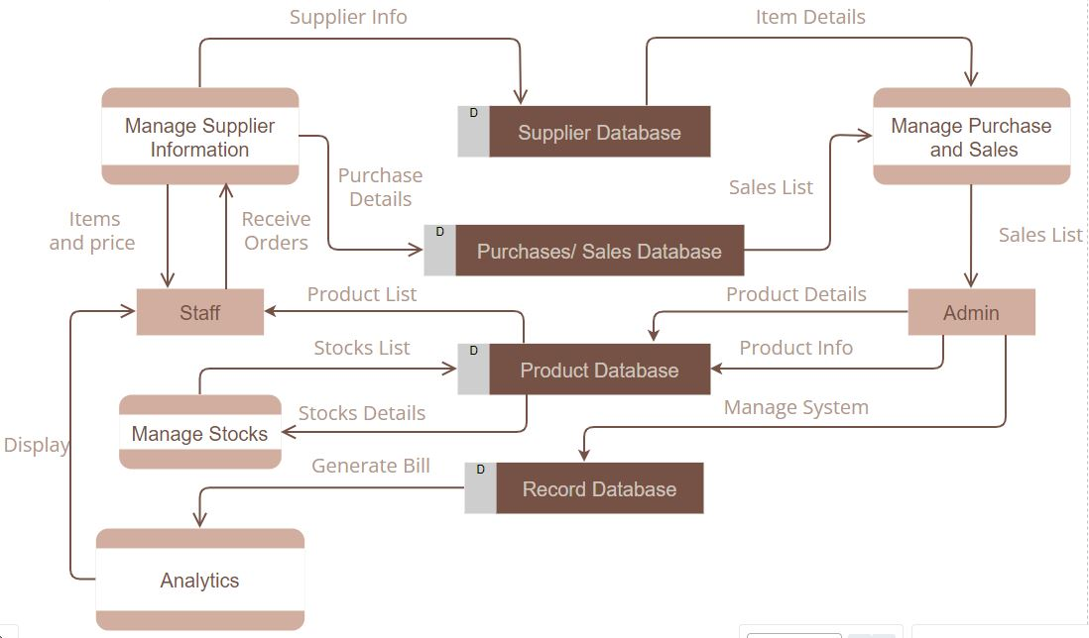
Project analysis slide 4
Physical DFD
Fig 8: Physical DFD

Slide 22
Project analysis slide 4
Algorithm – Rule Based- Purchase
1. Database Query:
Prepare a SQL query to retrieve purchase data grouped by the date of creation.
Execute the query and store the result in $result_all_time.
2. Data Processing:
Initialize an empty associative array $purchase_data_all_time to store purchase data.
Loop through the query result and populate $purchase_data_all_time with date as keys and total purchase as values.
Calculate the total purchase for all time using array_reduce.
Determine the all-time high and low purchases using max and min functions.
Sort the purchase data array in descending order by key using krsort.
Retrieve the latest month's purchase data.
3. Purchase Summary Calculation:
Calculate the average purchase for all time.
Calculate the total purchase for the current year.
4. Rule-Based Suggestion Generation:
Initialize an empty string $suggestion.
Evaluate conditions based on the current month's purchase, average purchase, and current year's purchase.
Assign a suggestion based on the satisfied condition.

Slide 23
Project analysis slide 4
Algorithm – Rule Based- Purchase
5. Rule-Based Message Generation:
Construct a message ($purchase_message) with formatted information and include the generated suggestion.
Display the message within an HTML div with the ID 'purchase-suggestion'.
6. Output:
Echo the generated message to the HTML page using echo.
Rule 1:
Condition: If the current month's purchase is less than the average purchase for all time.
Suggestion: "Consider increasing your purchases to meet your demand."
Rule 2:
Condition: If the current month's purchase is greater than the current year's total purchase.
Suggestion: "Consider decreasing your purchases to avoid surplus inventory."
Rule 3:
Condition: If none of the previous conditions are met.
Suggestion: "Your current purchase level seems to be appropriate. Keep up the good work!"

Slide 24
Project analysis slide 4
Algorithm – Rule Based- Sales
1. Database Query:
Prepare a SQL query to retrieve sales data grouped by the date of creation.
Execute the query and store the result in $result_all_time.
2. Data Processing:
Initialize an empty associative array $sales_data_all_time to store sales data.
Loop through the query result and populate $sales_data_all_time with date as keys and total sales as values.
Calculate the total sales for all time using array_reduce.
Determine the all-time high and low sales using max and min functions.
Sort the sales data array in descending order by key using krsort.
Retrieve the latest month's sales data.
3. Sales Summary Calculation:
Calculate the average sales for all time.
Calculate the total sales for the current year.
4. Rule-Based Suggestion Generation:
Initialize an empty string $suggestion.
Evaluate conditions based on the current month's sales, average sales, and current year's sales.
Assign a suggestion based on the satisfied condition.

Slide 25
Project analysis slide 4
Algorithm – Rule Based- Sales
5. Rule-Based Message Generation:
Construct a message ($sales_message) with formatted information and include the generated suggestion.
Display the message within an HTML div with the ID 'sales-suggestion'.
6. Output:
Echo the generated message to the HTML page using echo.
Rule 1:
Condition: If the current month's sales are less than the average sales for all time.
Suggestion: "Rule 1: Consider increasing your sales efforts to meet your demand."
Rule 2:
Condition: If the current month's sales are greater than the total sales for the current year.
Suggestion: "Rule 2: Consider decreasing your sales efforts to avoid overselling."
Rule 3:
Condition: If none of the previous conditions are met.
Suggestion: "Rule 3: Your current sales level seems to be appropriate. Keep up the good work!"

Slide 26
Project analysis slide 4
Algorithm – Rule Based- Stock Analysis
1. Database Query and Data Retrieval:
Execute a SQL query to retrieve stock data containing the date of creation (date_created) and quantity (quantity).
Store the retrieved data in the $stock_data array.
2. Sort Stock Data:
Copy the stock data to the sortedData array.
Sort sortedData in descending order based on the quantity of items.
3. Identify Dates with Highest, Lowest, and Mid-Level Stock:
Extract the date of creation for the stock entry with the highest quantity (highestStockDate).
Extract the date of creation for the stock entry with the lowest quantity (lowestStockDate).
Find the index of the stock entry with mid-level quantity (midStockIndex) and extract its date of creation (midStockDate).
4. Generate Suggestions:
Clear any previous suggestions in the HTML element with the ID 'suggestions-list'.
Create three list items (li) to represent each rule-based suggestion:
Rule 1: Suggests reducing stock for the date with the highest stock quantity.
Rule 2: Suggests ordering more stock for the date with the lowest stock quantity.
Rule 3: Suggests considering restocking for the date with mid-level stock quantity.

Slide 27
Project analysis slide 4
Algorithm – Rule Based- Top Seller
1. Initialization and Variables:
Initialize variables to track maximum and minimum sales for both this year and all time.
Initialize a variable to store the total sales.
2. Iterating Through Sales Data:
Loop through the sales data to calculate total sales and identify clients with the highest and lowest sales for both this year and all time.
3. Finding Middle Sales Person:
Determine the salesperson who has sold closest to the median total sales amount.
4. Outputting Results:
Display the highest and lowest sales for this year and all time, along with the corresponding clients.
Provide suggestions based on rule-based conditions:
Rule 1: Calculate the amount by which the person with the lowest sales this year needs to increase to catch up to the person with the highest sales this year.
Rule 2: Calculate the amount by which the person with the lowest all-time sales needs to increase to catch up to the person with the highest all-time sales.
Rule 3: Identify the salesperson who has sold closest to the median total sales amount.

Slide 28
Project analysis slide 4
Algorithm – Rule Based- Quantity Flow
1. Database Queries and Data Retrieval:
Execute a SQL query to retrieve stock data (date_created and quantity) from the stock_list table.
Store the stock data in the $stock_data array.
Execute a SQL query to retrieve purchase data (item_id and total quantity total_quantity) from the po_items table.
Store the purchase data in the $purchase_data array.
2. Sort Stock and Purchase Data:
Sort the stock data (sortedStockData) in descending order based on the quantity of items.
Sort the purchase data (sortedPurchaseData) in descending order based on the total quantity ordered.
3. Identify Dates and Items:
Find dates with the highest, lowest, and mid-level stock from sortedStockData.
Identify the item with the highest total quantity ordered from sortedPurchaseData.
4. Generate Suggestions:
Clear any previous suggestions in the HTML element with the ID 'suggestions-list'.
Create four list items (li) to represent each rule-based suggestion:
Rule 1: Suggests reducing stock for the date with the highest stock quantity.
Rule 2: Suggests ordering more stock for the date with the lowest stock quantity.
Rule 3: Suggests considering restocking for the date with mid-level stock quantity.
Rule 4: Suggests purchasing less of the item with the highest total quantity ordered.

Slide 29
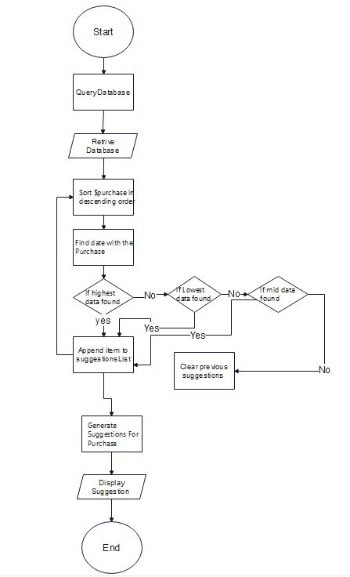
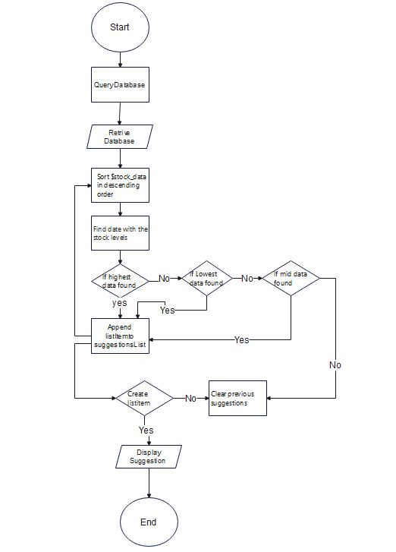
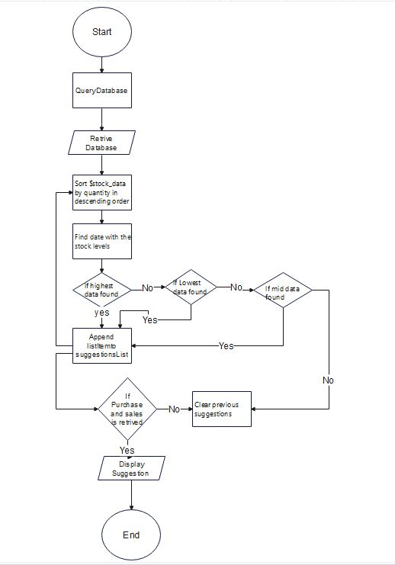
Project analysis slide 4
Flow chart
Fig 9: Purchase Flow Chart
Fig 10: Sales Flow Chart
Fig 11: Quantity Flow Chart

Slide 30
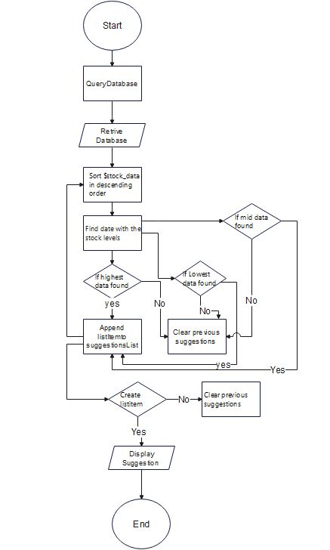
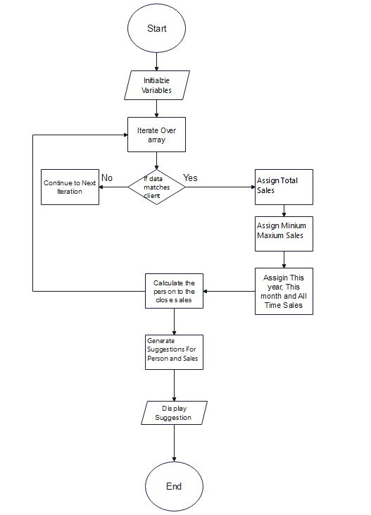
Project analysis slide 4
Flow Chart
Fig 12: Stock Analytics Flow Chart
Fig 13: Top Seller Flow Chart

Slide 31
Project analysis slide 4
Implementation
Implementation usually consists of coding; testing, installation, documentation, training and support.
It is basically converting system design specification into working software.
Tools Used
1 HTML 1 PHP
2 CSS 2 MYSQL
3 JAVASCRIPT
4 BOOTSTRAP
FRONT END
BACK END

Slide 32
Project analysis slide 4
Implementation Details of Modules
• Header: It displays the header with the logo of the Stock management system website, or the login. It is used in the navbar of the homepage. It is used in order to provide links to different pages of the website.
• Login Form: It is used in order to provide the user the gateway to the website. It uses the data like username and password from register form to authenticate the user and give further access.
• Home Page: This would serve as the main page of the application. It would display an overview of the system, including key performance indicators, such as inventory levels, sales, and purchases.
• Purchase Order Page: This page would allow users to create purchase orders for products. It would include a form for entering details about the purchase, such as the supplier, the products being ordered, and the quantity.
• Back Order Page: This page would allow users to create back orders for products that are out of stock. It would include a form for entering details about the back order, such as the supplier, the products being ordered, and the quantity.
• Return Order Page: This page would allow users to initiate return orders for products that are defective or not as described. It would include a form for entering details about the return, such as the product being returned and the reason for the return.
• Receive Order Page: This page would allow users to receive and record deliveries of products from suppliers. It would include a form for entering details about the delivery, such as the supplier, the products received, and the quantity.

Slide 33
Project analysis slide 4
Implementation Details of Modules
• Sales Order Page: This page would allow users to create sales orders for products. It would include a form for entering details about the sale, such as the customer, the products being sold, and the quantity.
• Supplier Page: This page would allow users to manage supplier information, such as adding new suppliers, updating supplier details, and deleting suppliers.
• Analytics Page: This page would allow users to view analytics and reports about the system, such as sales trends, inventory levels, and supplier performance

Slide 34
Project analysis slide 4
Testing
Testing is done to check the behaviour of a complete and fully integrated software product based on the software requirement specification document. For the application or website to be deployed it has to be tested.
1. Login Page:
• Verify that valid credentials allow the user to log in.
• Verify that invalid credentials result in an error message.
2. Home Page:
• Verify that all the links and buttons on the home page work as expected.
• Verify that the navigation menu is correctly displayed and functional.
3. Purchase Order Page:
• Verify that the page allows the user to create a new purchase order.
• Verify that the user can add products to the purchase order.
• Verify that the purchase order is saved correctly in the database.
• Verify that the user can edit and delete the purchase order.
4. Back Order Page:
• Verify that the page allows the user to create a new back order.
• Verify that the user can add products to the back order.
• Verify that the back order is saved correctly in the database.
• Verify that the user can edit and delete the back order.

Slide 35
Project analysis slide 4
Testing
5. Return Order Page:
• Verify that the page allows the user to create a new return order.
• Verify that the user can add products to the return order.
• Verify that the return order is saved correctly in the database.
• Verify that the user can edit and delete the return order.
6. Receive Order Page:
• Verify that the page allows the user to receive products from a purchase order.
• Verify that the user can update the inventory levels.
• Verify that the received products are saved correctly in the database.
7. Sales Order Page:
• Verify that the page allows the user to create a new sales order.
• Verify that the user can add products to the sales order.
• Verify that the sales order is saved correctly in the database.
• Verify that the user can edit and delete the sales order.
8. Supplier Page:
• Verify that the page displays a list of all the suppliers.
• Verify that the user can add, edit, and delete suppliers.
• Verify that the supplier details are saved correctly in the database.

Slide 36
Project analysis slide 4
Testing
9. Analytics Page:
• Verify that the page displays the relevant data in a meaningful way.
• Verify that the graphs and charts are accurate and up-to-date.
• Verify that the user can filter and sort the data as needed.

Slide 37
Project analysis slide 4
Unit Testing
S.No | Test Case Description | Test Data | Expected Result | Actual Result | Pass/Fail
1 | Verify that the login page loads correctly | N/A | Login page is displayed | Login page is displayed | Pass
2 | Verify that valid credentials allow the user to log in | Username:admin, Password: admin123 | User is logged in | User is logged in | Pass
3 | Verify that invalid credentials result in an error message | Username: invaliduser, Password: invalidpassword | Error message is displayed | Error message is displayed | Pass
4 | Verify that the purchase order page loads correctly | N/A | Purchase order page is displayed | Purchase order page is displayed | Pass
5 | Verify that the user can add products to the purchase order | Product: Widget, Quantity: 10 | Product is added to the purchase order | Product is added to the purchase order | Pass
6 | Verify that the purchase order is saved correctly in the database | Purchase order details | Purchase order is saved in the database | Purchase order is saved in the database | Pass
Register page test case
Fig: Register page test case

Slide 38
Project analysis slide 4
Unit Testing
S.No | Test Case Description | Test Data | Expected Result | Actual Result | Pass/Fail
7 | Verify that the user can edit and delete the purchase order | Purchase order ID: 123, New quantity: 20 | Purchase order is updated in the database | Purchase order is updated in the database | Pass
8 | Verify that the supplier page loads correctly | N/A | Supplier page is displayed | Supplier page is displayed | Pass
9 | Verify that the user can add suppliers | Supplier details | Supplier is added to the database | Supplier is added to the database | Pass
10 | Verify that the user can edit and delete suppliers | Supplier ID: 456, New address: Kathmandu` | Supplier details are updated in the database | Supplier details are updated in the database | Pass
Register page test case
Fig: Register page test case

Slide 39
Project analysis slide 4
System Testing
S.No | Test Case Description | Test Data | Expected Result | Actual Result | Pass/Fail
1 | Verify that valid credentials allow the user to log in | Username: testuser, Password: testpassword | User is logged in | User is logged in | Pass
2 | Verify that invalid credentials result in an error message | Username: invaliduser, Password: invalidpassword | Error message is displayed | Error message is displayed | Pass
3 | Verify that all the links and buttons on the home page work as expected | N/A | Links and buttons work as expected | Links and buttons work as expected | Pass
4 | Verify that the navigation menu is correctly displayed and functional | N/A | Navigation menu is displayed and functional | Navigation menu is displayed and functional | Pass
5 | Verify that the purchase order page allows the user to create a new purchase order | Supplier: ABC Company, Product: Item2, Quantity: 10 | Purchase order is created | Purchase order is created | Pass
6 | Verify that the back order page allows the user to create a new back order | Supplier: XYZ Company, Product:Itme1, Quantity: 5 | Back order is created | Back order is created | Pass
7 | Verify that the return order page allows the user to create a new return order | Customer: Milan Karki, Product: Defective Widget, Quantity: 1 | Return order is created | Return order is created | Pass
Register page test case
Fig: Register page test case

Slide 40
Project analysis slide 4
Conclusion
After the successful completion of Stock Management System that incorporates all the necessary functionalities for efficient stock management.
The current application has fulfilled all the objectives.
We followed the specifications strictly but enhanced some of the features when there was need it to be done.
There have been challenges especially when it came to backend and making sure that the application responses in a predictable manner.
Choosing PHP for this project is because it is very simple and easy to use, it could handle a lot of data and easily manipulation compared to another scripting language, this is widely used all over the world. it is Open source; we can freely download and use. And it is platform independent as well.

Slide 41
Project analysis slide 4
Future Recommendation
Here is what can be added in the future on this website to increase its usability, user experience and portability of the website. There is a lot to be done hence this application can be considered as a starting point for something big to come
• Integration with barcode scanners.
• Integration with automated re-ordering systems.
• Advanced analytics and reporting.
• Integration with ecommerce platforms.
• Mobile app

Slide 42
Project analysis slide 4
Reference
[1]techtarget.com,“techtarget.com,”.[Online].Available:https://www.techtarget.com/searchcio/definition/stock. [Accessed 1 5 2023].
[2] erdplus.com, ”erdplus.com”, [Online].Available:https://erdplus.com/standalone. [Accessed 5 5 2023].
[3]researchgate.net.”researchgate.net”,[Online].Available:https://www.researchgate.net/publication.[Accessed 3 5 2023].
[4] Ramesh singh saudh , System Analysis and Design, Ktm: KEC Publication, 2020(Revised).
[5] Ramesh singh saudh , Software Engineering, Ktm: KEC Publication, 2020(Revised).
[6] Alexandre de Castro Moura and Alessandra Angelucci, "A System for Stock Management of Clothing Retail Companies," Procedia Manufacturing, vol. 39, pp. 545-554, 2019.
[7] G. H. Hashmi, M. H. Jamil, and A. I. Sheikh, "Development of an Automated Inventory Management System using RFID," International Journal of Advanced Computer Science and Applications, vol. 8, no. 5, pp. 322-327, 2017.
[8] Imran Khan, "Development of an Inventory Management System for Small Business," International Journal of Computer Applications, vol. 180, no. 36, pp. 34-40, 2018.
[9] Alexandre de Castro Moura and Alessandra Angelucci, "An Analysis of the Use of Barcodes and RFID in Stock Management of a Clothing Retail Company," Journal of the Brazilian Society of Mechanical Sciences and Engineering, vol. 41, no. 11, pp. 1-12, 2019.
[10] J. A. N. Martins and J. M. F. Calado, "A Framework for Stock Management in Small and Medium-sized Enterprises," International Journal of Production Economics, vol. 132, no. 2, pp. 294-305, 2011.

Slide 43
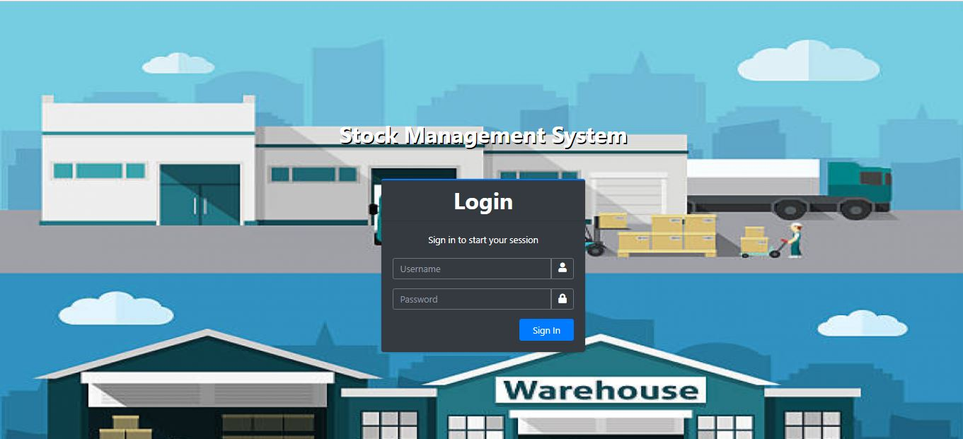
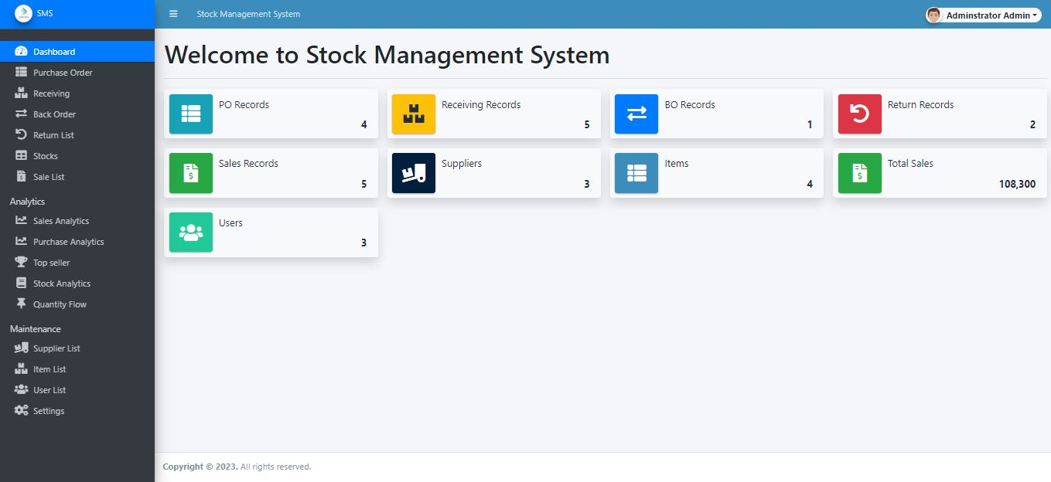
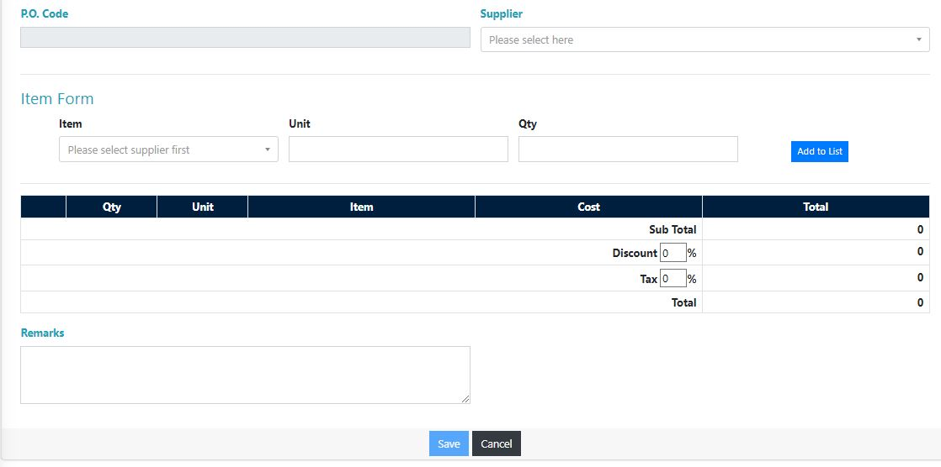
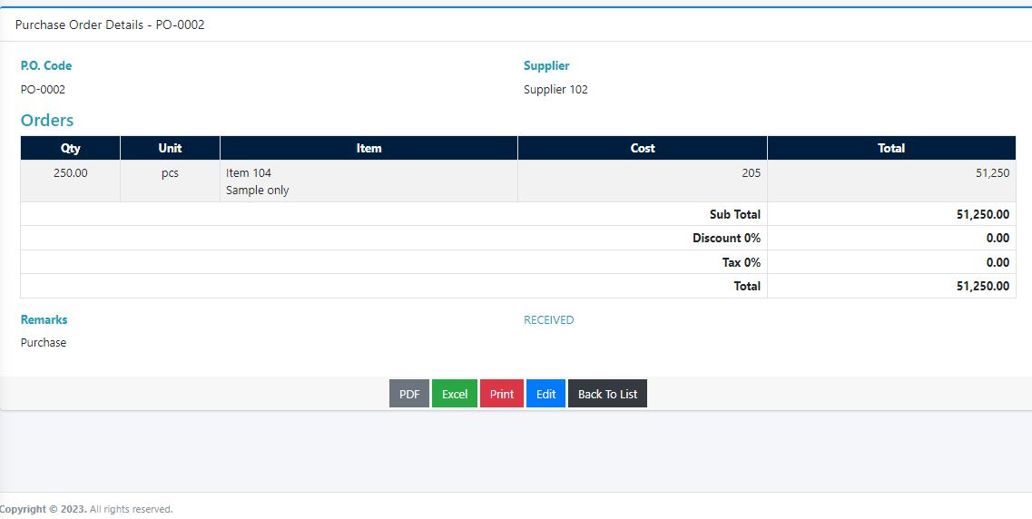
Project analysis slide 4
APPENDICES

Slide 44
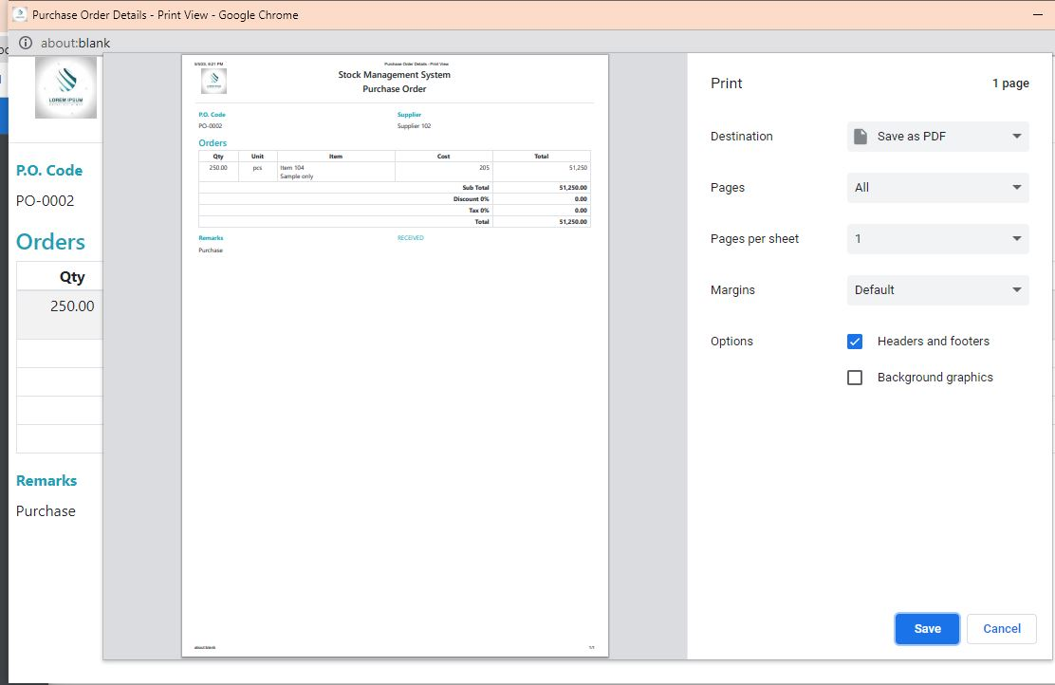
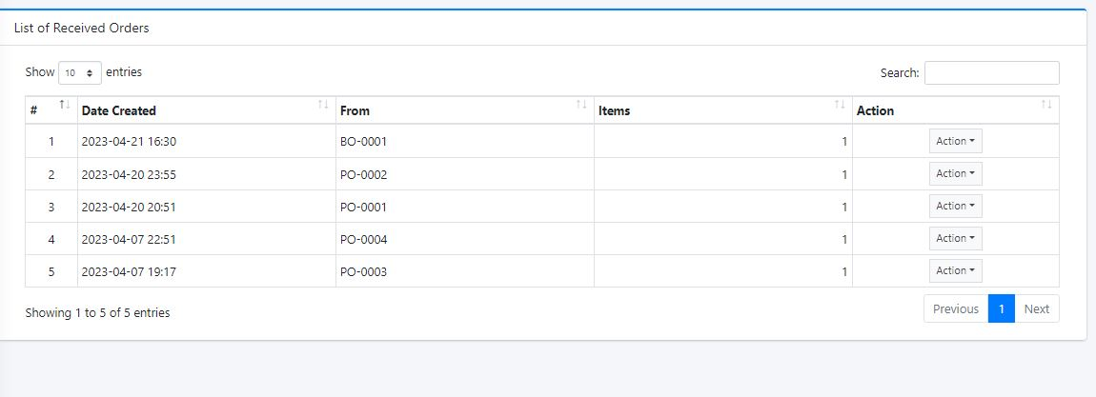
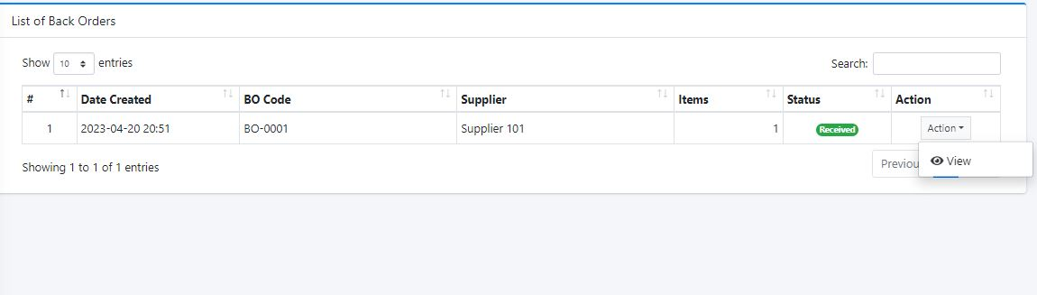
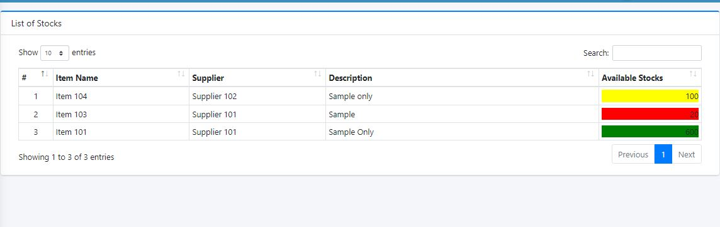
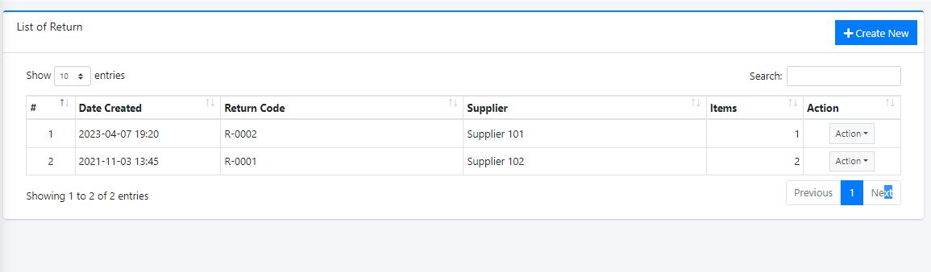
Project analysis slide 4
APPENDICES

Slide 45
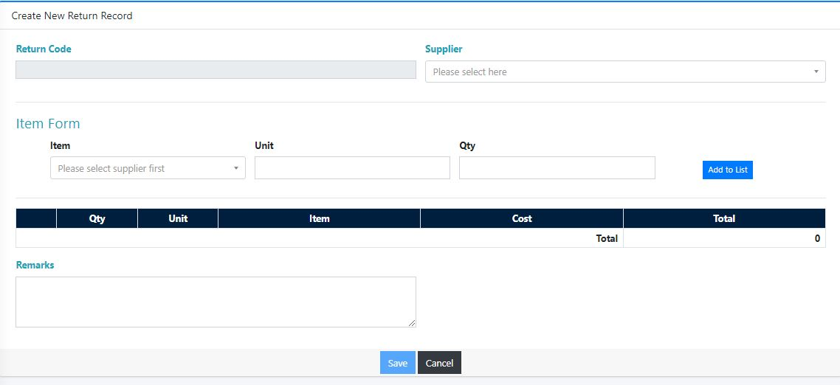
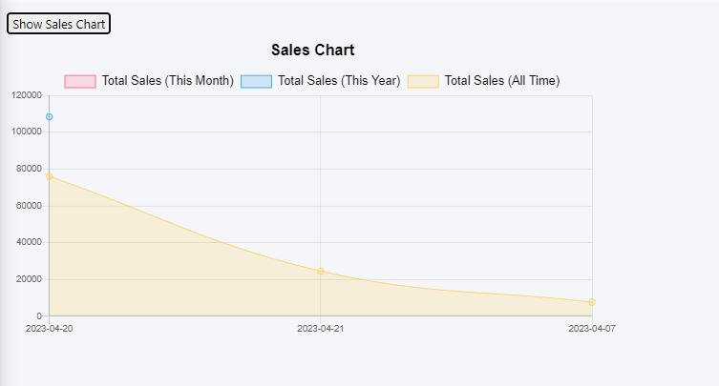
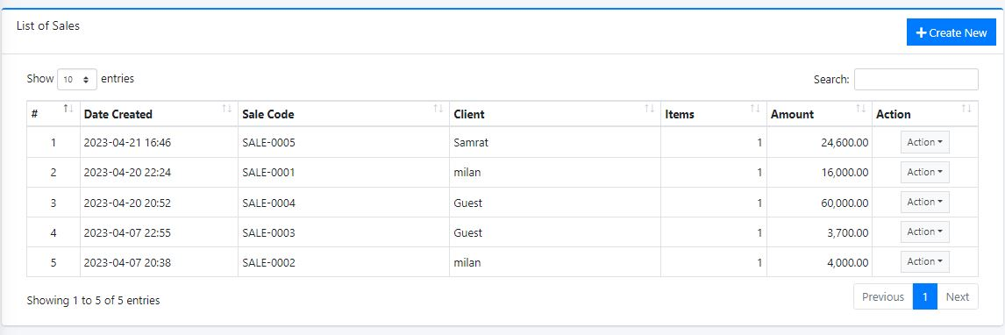
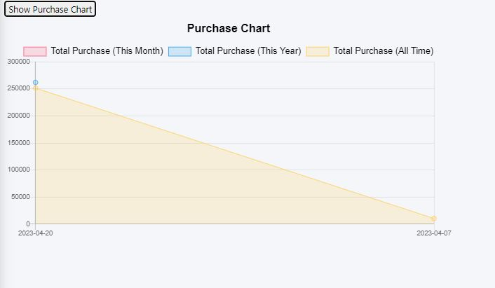
Project analysis slide 4
APPENDICES

Slide 46
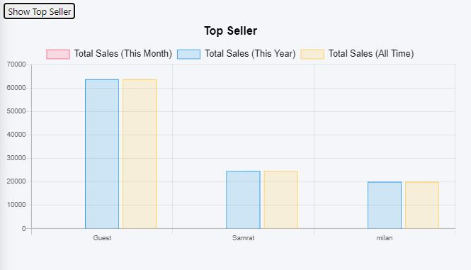
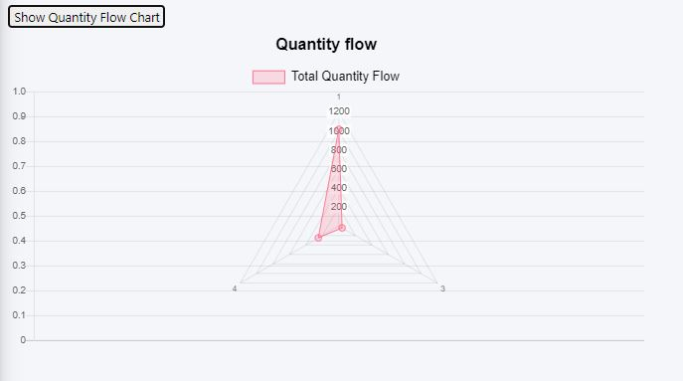
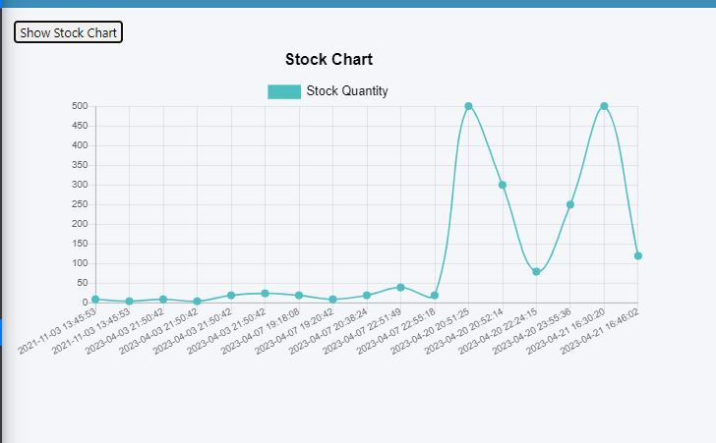
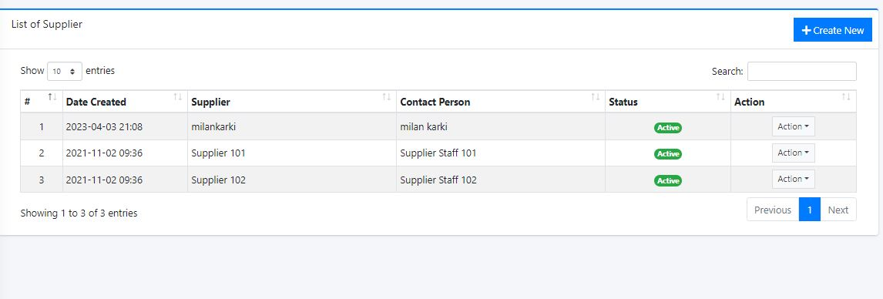
Project analysis slide 4
APPENDICES

Slide 47
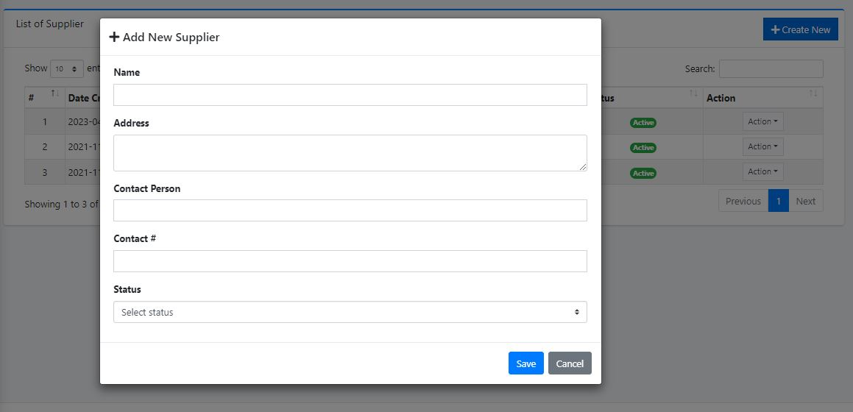
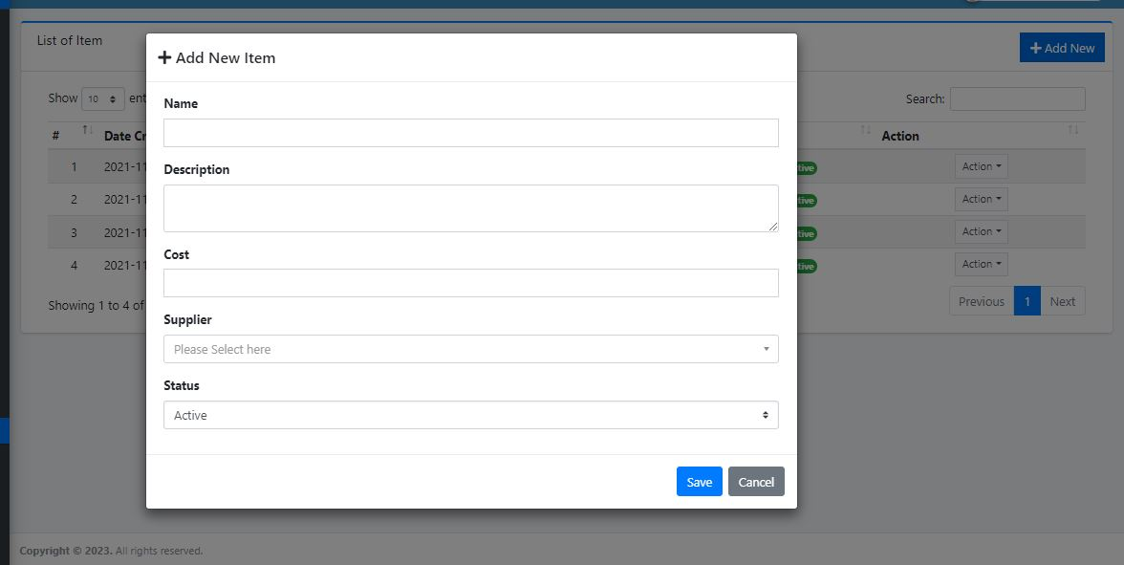
Project analysis slide 4
APPENDICES

Slide 48

Project analysis slide 4
Any Question?

Slide 49
Thank You

